Slide 1
Database Management: Analysis through an API Call
MSA 8040 Data Management for Analytics
Tyler Trocchi,
Jasmine Weekes,
Athina Osei Kyeremateng,
Jared Jones

Slide 2

Data Selection and Extraction
API Call: We decided to work with the Zillow API for our project and focus on the area of Snellville, Ga.
Key Features: Data on real estate estimates, property details (sq ft, bedrooms, bathrooms), market trends based on location, etc.

Slide 3
Data Loading
API Call
GET Request
JSON File
Dataframe Creation
After making the API call, we used a Python script to define the headers and the parameters.
We then used these to complete a Get request, which we then parsed into a JSON file.
Using the JSON file, we used the concat function to convert the data into a Pandas data frame.

Slide 4
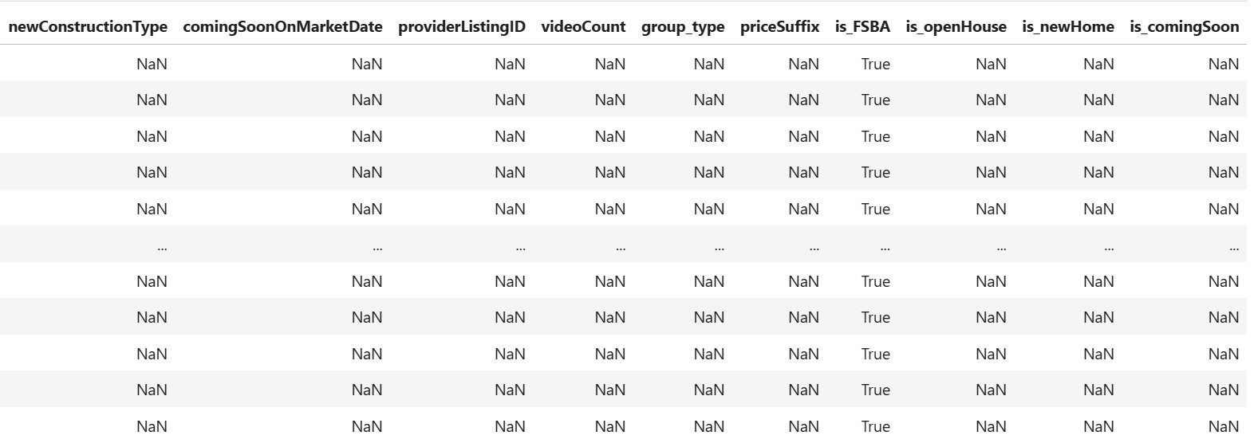
Data Validation
This dataset had 9 columns which were mostly null, so we filtered these columns out.
From the remaining columns with null values, we used the mean values from these columns as filler values and loaded the cleaned data into the table.

Slide 5
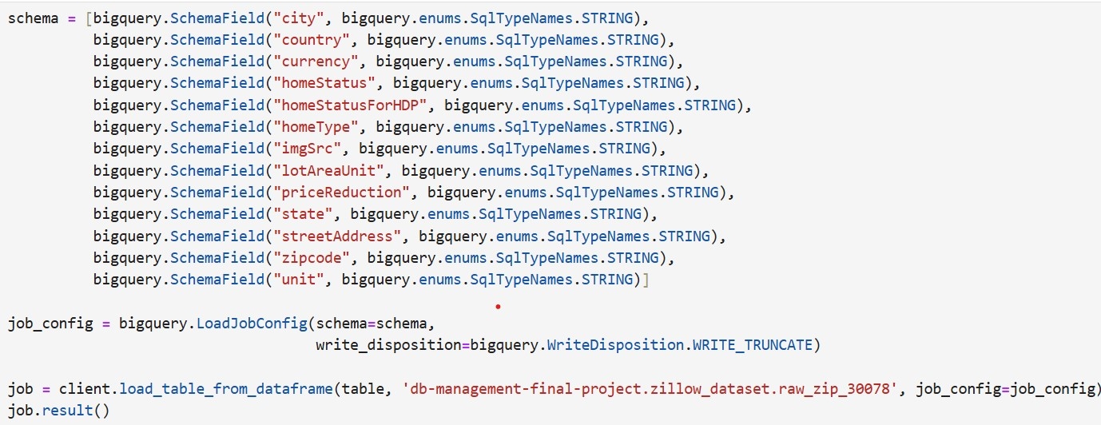
Loading Data into BigQuery Table
Once we had the data in a pandas data frame, this allowed us to create a schema using the SchemaField() function from the Google Cloud BigQuery package on Python.
From here we loaded in the data frame using the load_table_from_dataframe() function from the same package.

Slide 6
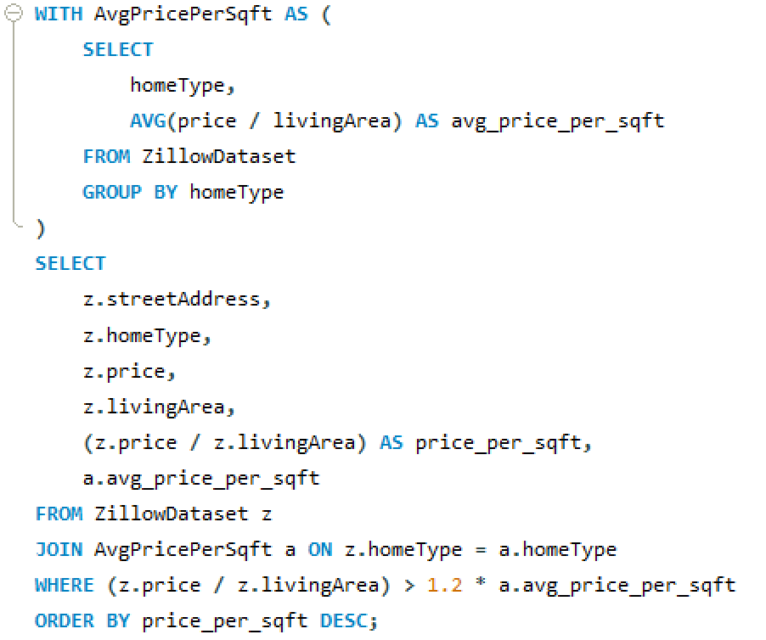
Analyzing Overly Priced Homes
Aim: Determine overly priced homes based on size.
Method: The query calculated the average prices of homes according to home type and compared it to individual home prices.
Logic: Homes which were more than 120% of the average price were determined as overpriced.

Slide 7
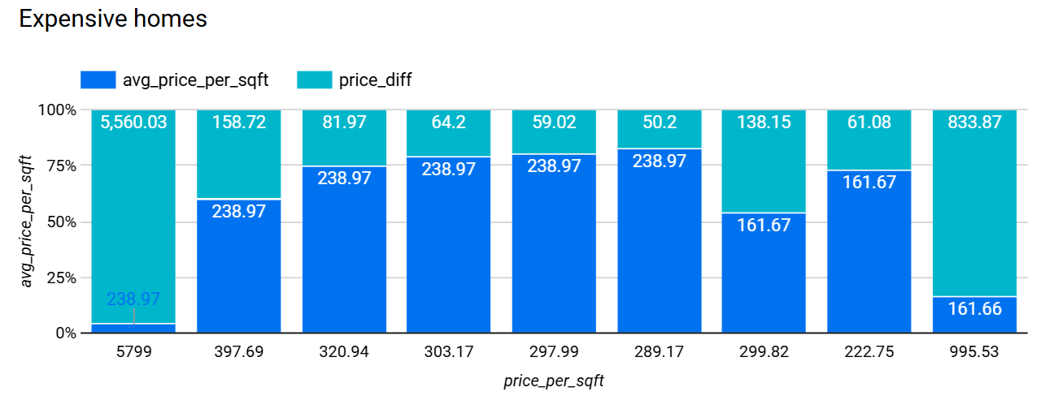
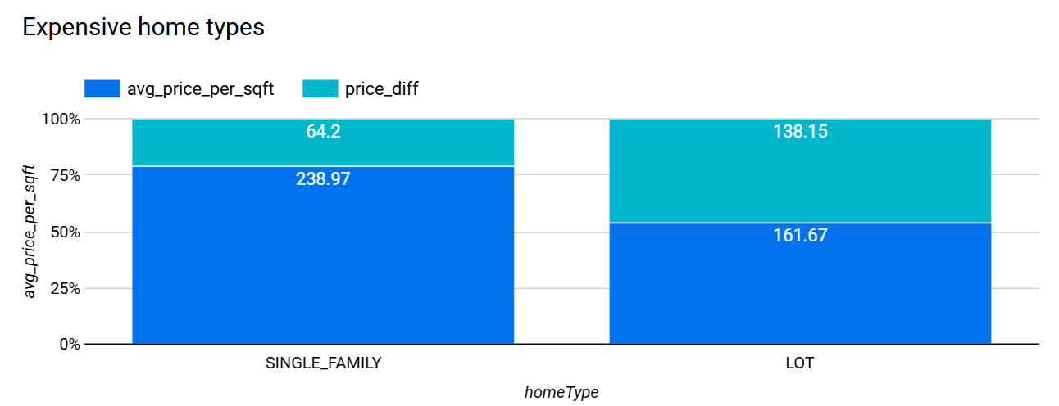
Results
9 homes were overpriced in the city of Snellville.
Three of these homes are more than 60% higher than average.
All overpriced homes were either single family or lot hometypes.
Lot home types are generally the most overpriced.

Slide 8
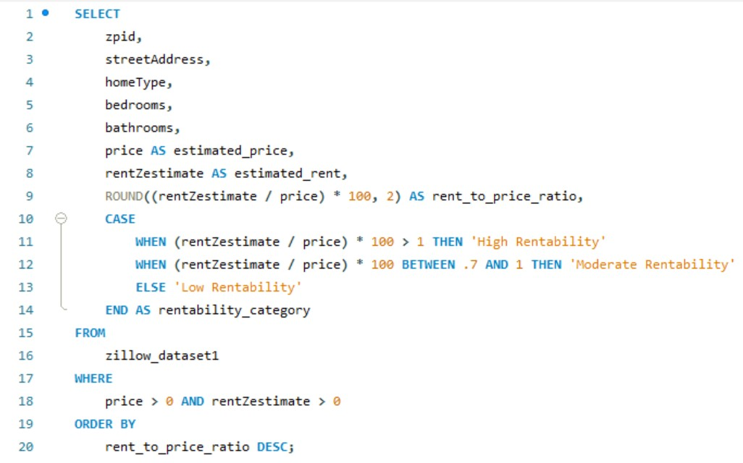
Rental vs Sale Profitability
One of the queries that we ran aimed to answer a question from a property owner's perspective: which properties are more profitable to rent than to sell outright?
This query created a metric called the rent to price ratio, and categorized each property as a low, moderate, or highly rentable property in terms of profitability for the owner.

Slide 9
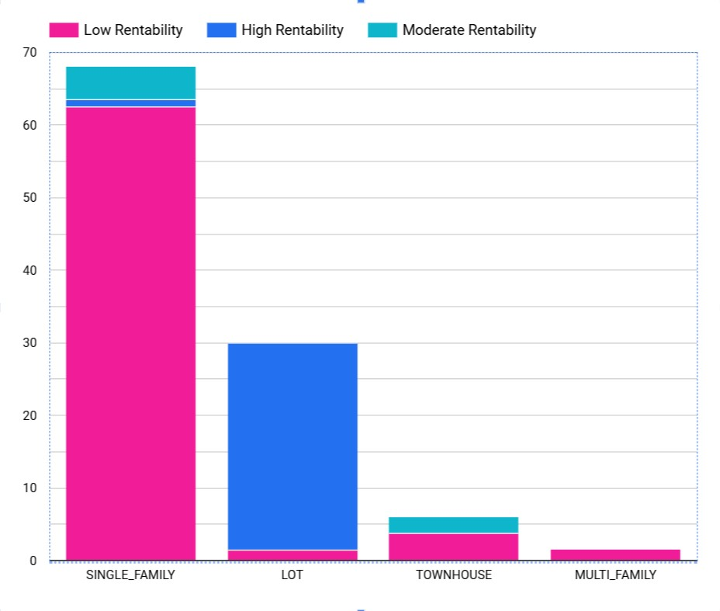
Results
This visualization shows the breakdown of each rentability category within each home type.
Insights: Large majority of single-family homes are not profitable to rent, large majority of lots are profitable to rent.
Conclusion: Outside of lots, these homes are much more profitable to sell than to rent.

Slide 10
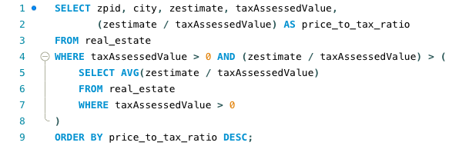
Analyzing Zillow Estimates vs. Tax-Assessed Value
Goal: Identify properties where Zillow's estimate ("Zestimate") is significantly higher than the tax assessed value.
This query identifies the homes where the ratio between its Zestimate and determined tax assessed value is greater than the total average ratio.

Slide 11
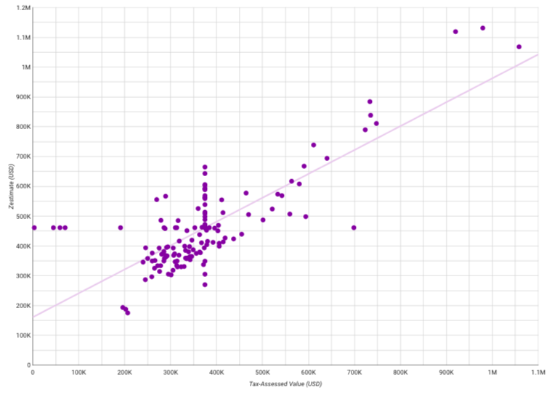
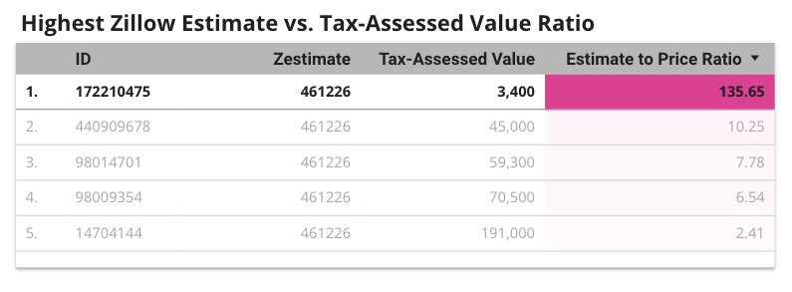
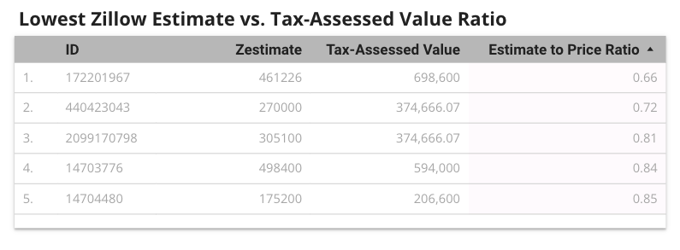
Results
Listings with the highest and lowest Zestimate-to-Assessed Value ratio
Helps identify which homes may need to be re-estimated by Zillow
Over- estimated? Error in Zestimate?
Under-estimated?

Slide 12
Thank You

